Slide 1

Cryptography
Past, Present, and Future

Slide 2
Historical Cryptography
7th Century BC – Scytale
1st Century BC – Caeser Cipher
1500's - Vigenère Cipher

Slide 3
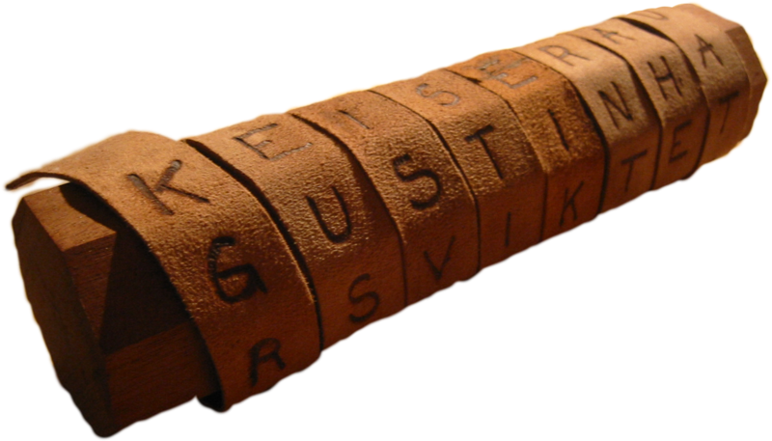
Scytale
As old as 7th century BC.
Used by ancient Roman military.
Transposition cipher.
May have been used as authentication, not encryption.
Notes:
Djekic, M. (2014, June 12). A Scytale – Cryptography of the Ancient Sparta. Australian Science. http://ozscience.com/technology/a-scytale-cryptography-of-the-ancient-sparta/.
Plutarch. (n.d.). Plutarch, Lysander. Plutarch, Lysander, chapter 19, section 5. http://www.perseus.tufts.edu/hopper/text?doc=Plut.%2BLys.%2B19.5&fromdoc=Perseus%3Atext%3A2008.01.0048.
Rhodes, B. (2020, April 23). Roman Cybersecurity: The Scytale. Medium. https://medium.com/tech-is-a-tool/the-birth-of-security-the-scytale-94d472aa480d.
Image CC BY-SA 3.0, https://commons.wikimedia.org/w/index.php?curid=1698345

Slide 4
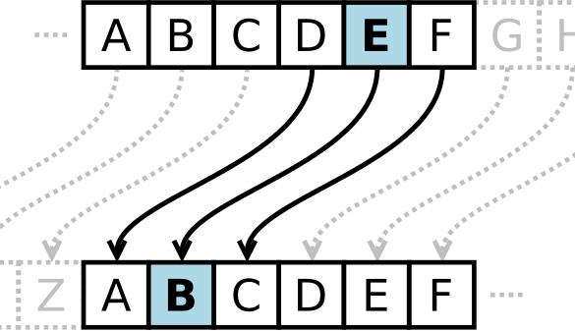
Caeser Cipher
As old as 1st century BC.
Used by ancient Roman military.
Shift-style, monoalphabetic substitution cipher.
Notes:
Reynard, R. (1996, August 1). Caesar Cipher History. Secret Code Breaker. http://www.secretcodebreaker.com/history2.html.
The Story of Cryptography: History. The Story of Cryptography : Historical Cryptography. (n.d.). https://ghostvolt.com/articles/cryptography_history.html.
Image By Matt_Crypto - http://en.wikipedia.org/wiki/File:Caesar3.png, Public Domain, https://commons.wikimedia.org/w/index.php?curid=30693472

Slide 5
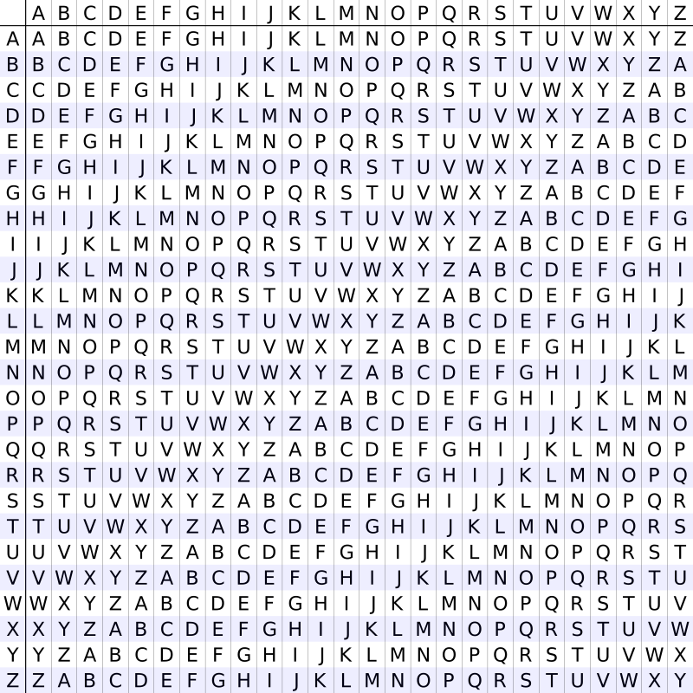
Vigenère Cipher
Developed in the 1500's.
Multi-alphabetic substitution cipher.
Cracked in the mid-1800's but saw continued use throughout the American Civil War.
Notes:
CNG. (2019, September 18). History of Cryptography: The Vigenère Cipher. Cangea. https://cangea.com/history-of-cryptography-the-vigenere-cipher/.
Simmons, G. J. (n.d.). Vigenère cipher. Encyclopædia Britannica. https://www.britannica.com/topic/Vigenere-cipher.
Vigenère Cipher. Vigenre Cipher. (n.d.). https://www.cryptomuseum.com/crypto/vigenere/.

Slide 6
Modern Cryptography
Rivest-Shamir-Adleman (RSA)
Advanced Encryption Standard (AES)

Slide 7
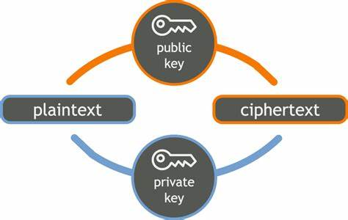
RSA
Developed in the 1970's by MIT students.
Uses a two key, asymmetric system.
Each user has a matching pair of keys:
Private key is kept secure locally.
Public key is shared with other users.
Relies on the difficulty of factoring large prime numbers.
Notes:
Leonard Adleman Made RSA Encryption History With His Invention. Made RSA Encryption History With His Invention. (n.d.). https://www.invent.org/inductees/leonard-adleman.
Sears, J. (2020, January 9). A fascinating story of RSA encryption. NordLocker. https://nordlocker.com/blog/rsa-encryption/.
Image via https://beyondvalence.blogspot.com/2014/03/rsa-encryption-and-decryption-in-r.html

Slide 8
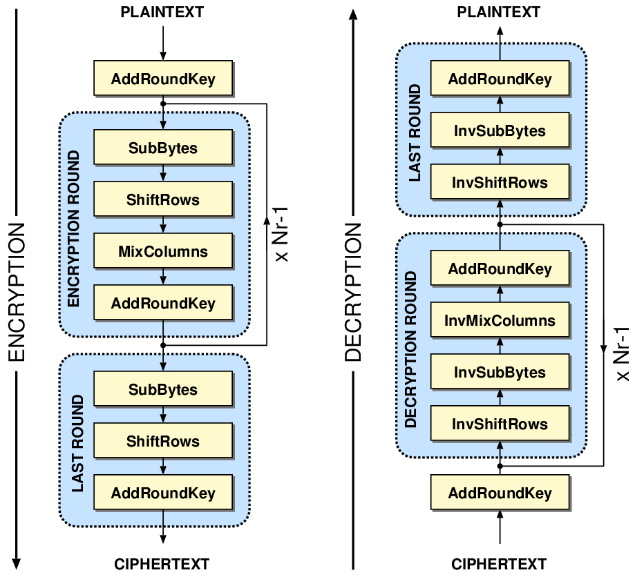
AES / Rijndael
Developed in the 1990's by Dutch cryptographers.
Symmetric block cipher encryption.
128-, 192-, and 256-bit keys.
Data goes through multiple rounds of sequential encryption, depending on key length.
Notes:
Crawford, D. (2019, February 4). AES Encryption: Everything you need to know about AES. ProPrivacy.com. https://proprivacy.com/guides/aes-encryption.
Rimkienė, R. (2020, December 11). What is AES Encryption and How Does It Work? CyberNews. https://cybernews.com/resources/what-is-aes-encryption/.
Image via https://crypto.stackexchange.com/questions/8043/aes-addroundkey

Slide 9
Future Cryptography
Quantum Computing
Homomorphic Encryption

Slide 10
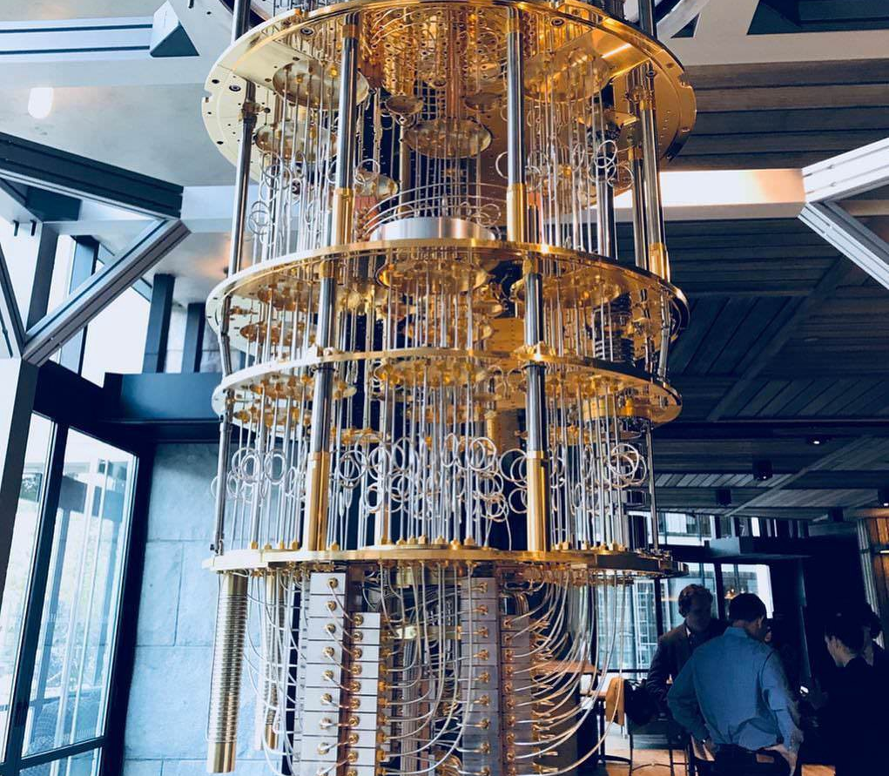
Quantum Computing
Machines operate on qubits instead of bits.
Based on quantum mechanics allowing qubits to exist as both on and off at the same time.
Algorithms already exist to quickly factor large prime numbers.
Notes:
IBM Explores the Future of Cryptography. IBM News Room. (n.d.). https://newsroom.ibm.com/IBM-Explores-the-Future-of-Cryptography.
Lauter, K. (2018, September 14). The Future of Cryptography. Queen Elizabeth Prize for Engineering. https://qeprize.org/news/the-future-of-cryptography/#:~:text=%20The%20Future%20of%20Cryptography%20%201%20An,the%20lattice-based%20cryptosystems%20mentioned%20earlier%20is...%20More%20.
Image via https://medium.com/swlh/quantum-computing-the-blockchain-killer-3700669af931

Slide 11
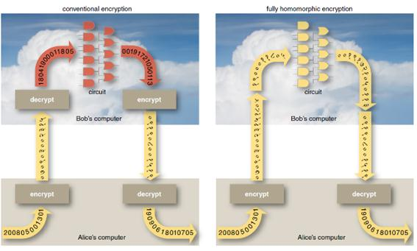
Homomorphic Encryption
New encryption standard for cloud computing.
Allows encrypted data to be mathematically and logically manipulated without being decrypted first.
Removes a major security risk in using cloud architecture.
Notes:
IBM Explores the Future of Cryptography. IBM News Room. (n.d.). https://newsroom.ibm.com/IBM-Explores-the-Future-of-Cryptography.
Lauter, K. (2018, September 14). The Future of Cryptography. Queen Elizabeth Prize for Engineering. https://qeprize.org/news/the-future-of-cryptography/#:~:text=%20The%20Future%20of%20Cryptography%20%201%20An,the%20lattice-based%20cryptosystems%20mentioned%20earlier%20is...%20More%20.
Image via http://article.sciencepublishinggroup.com/html/10.11648.j.iotcc.20160402.12.html

